Slide 1
Cell Phone Project:
Steven Barboza

Slide 2
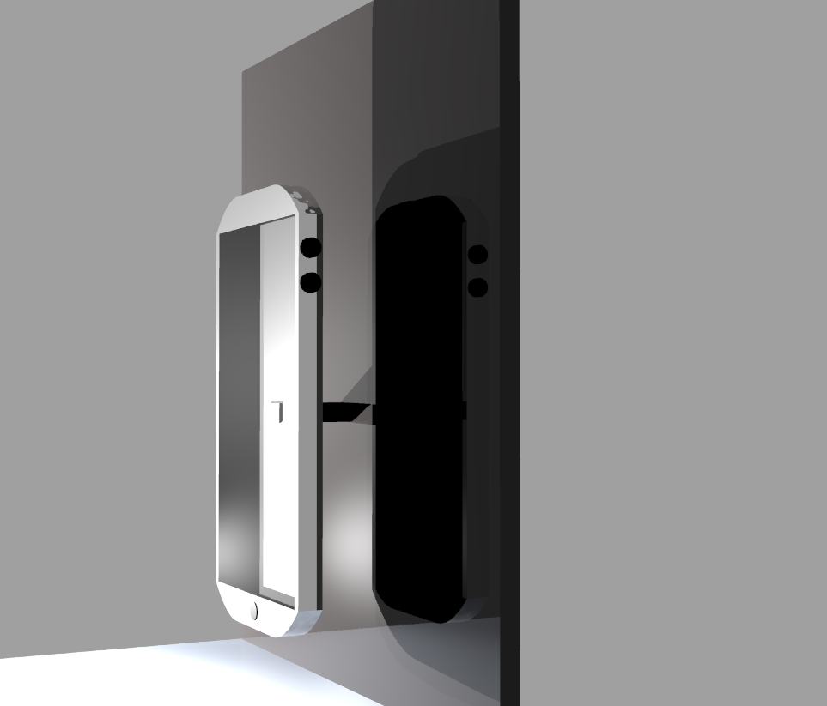
This is the first rendering of the cell phone project. It shows a side view, showing my cell phones sleek appearance. The phone features two buttons allowing to adjust volume on the right side of the phone.

Slide 3
Problems:
Making the phones screen to look realistic was one of the most hardest things to make with the phone, however after proper light placement I was able to make the screen look as real as possible.
- Another problem that I came across was making the outline or trim of the phone look good, using a chrome material, however lighting was key with this project, and after proper light placement it became to look good.

Slide 4
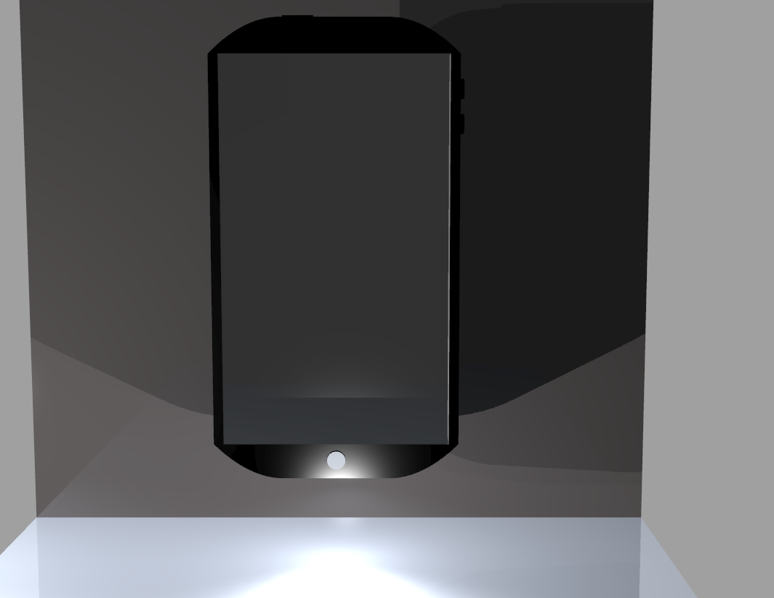
This is the front view of the phone. My goal in this project was to make a future smartphone, by increasing the screen size, and slimming the phones structure..making it easier for the user to hold or pocket the phone. Most large smartphones are not easy to pocket. My goal was to create the ultimate slim smartphone.

Slide 5
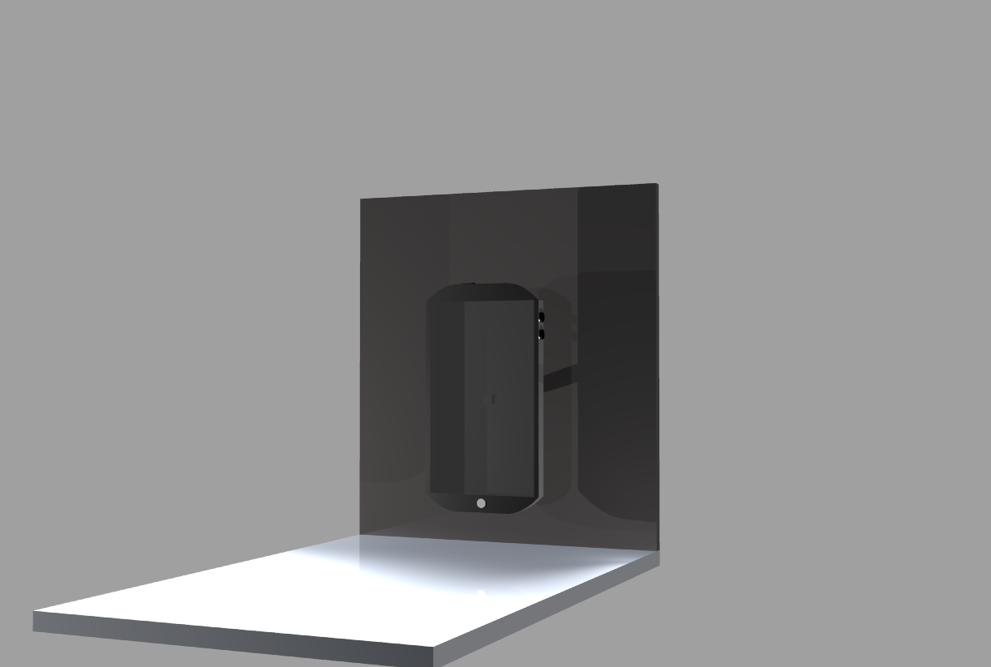
This is a far away rendering pf the phone, showing what the phone would look like in the distance.

Slide 6
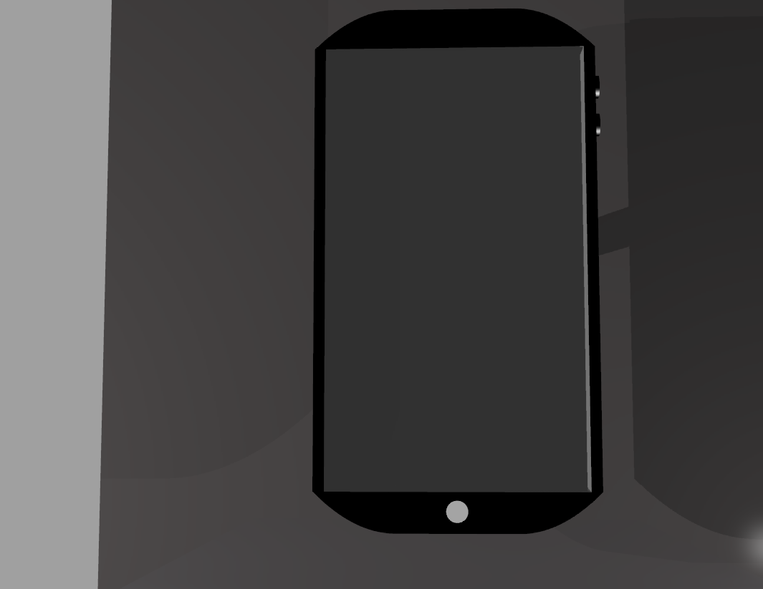
Here is another view of the front front of the phone.

Slide 7
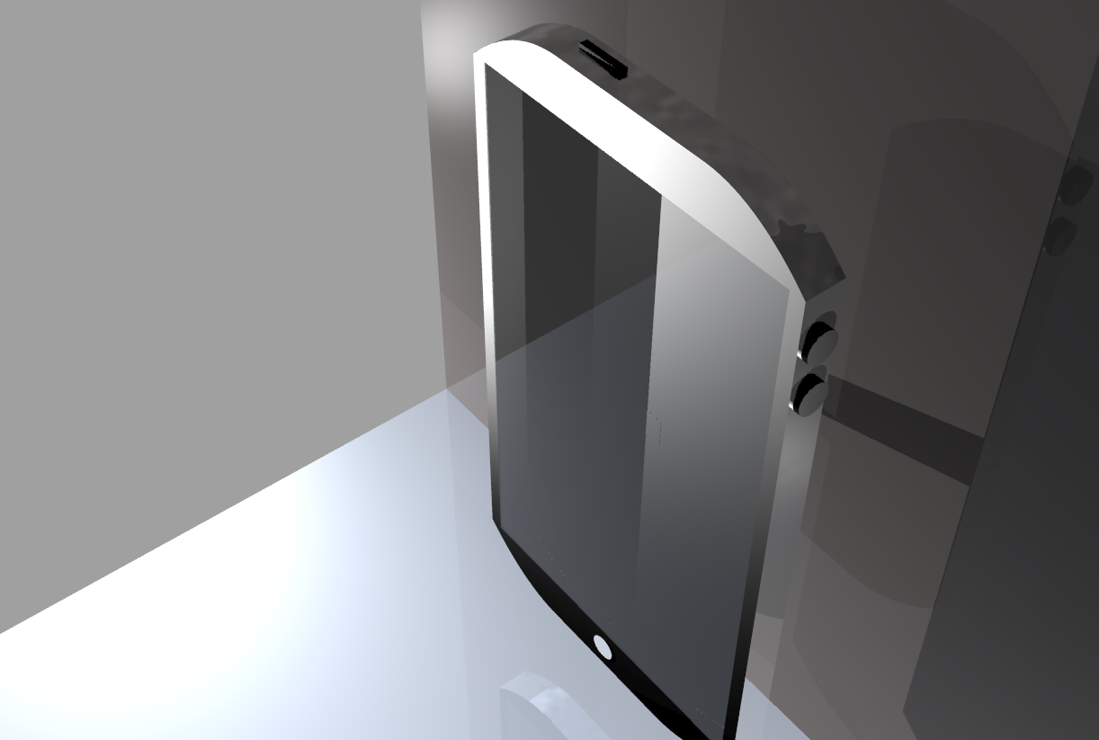
Here is the top/side of the phone. It shows a lock button, and a nice chrome finish with two volume control buttons.

Slide 8
Review:
My cell phone has a “Smartphone “ look that could possibly be the next design for a new iphone/ android device.
-The phone features a sleek design, with a nice finish. The phone is built with quality materials, such as chrome, and stainless steel. The phone will also have strong hardware, if used by apple It will run on the newest ios.

