Slide 1
Year 2 rhino projects
The guitar
By
Steven Barboza

Slide 2
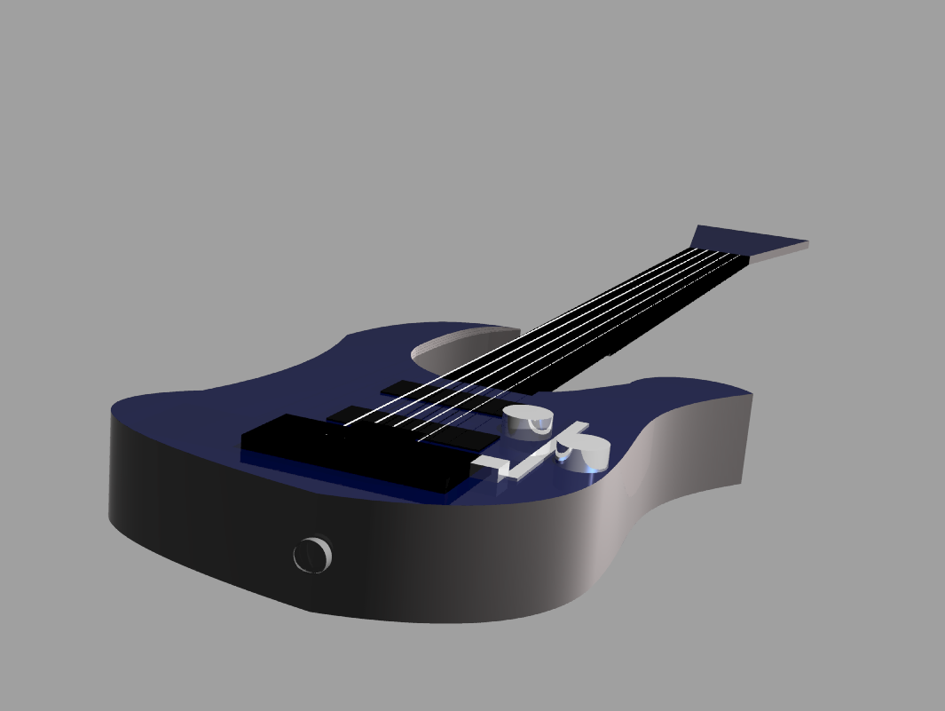
This is the basic structure of the guitar i have constructed. It features a blue, almost like chrome finish with gray sidings. The guitar also has hum bucker pickups with a floyd rose. It also has to chrome knobs to adjust volume and the pickup.

Slide 3
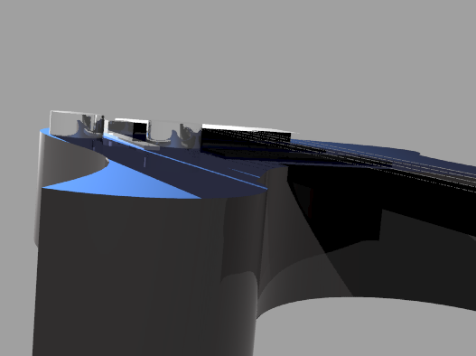
This is another rendering of the guitar's top finish. It also shows a better view of the strings meeting with the floyd rose.

Slide 4
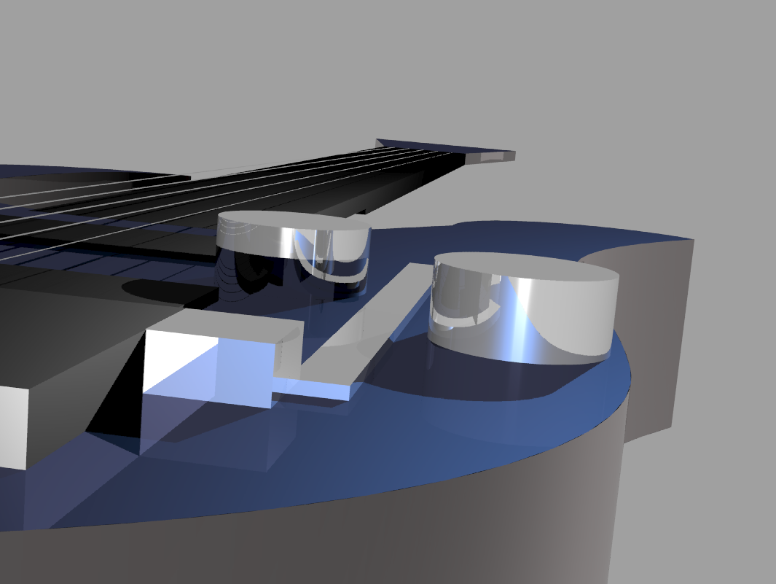
This is an up-close rendering of the floyd rose "whammy bar". The bar can be pulled out and can be removed from the guitar in order to not disrupt the tuning of the strings.

Slide 5
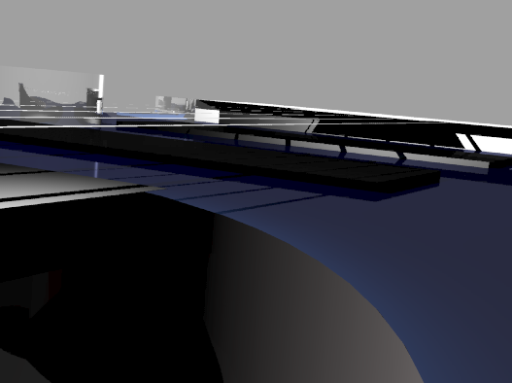
This rendering shows and up-close view on where the strings attach to the floyd rose and the pickups. The knobs can also be seen in the background as well.

Slide 6
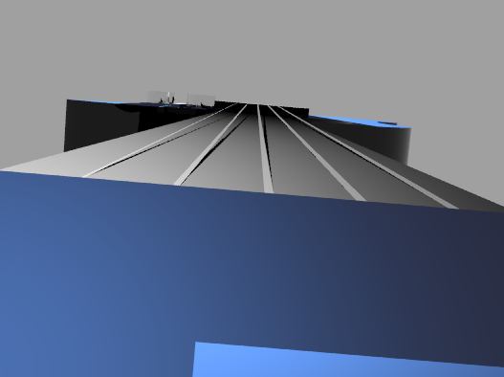
This is an view of the neck of the guitar and strings. The strings have been spaced out to the eficient distance of a real guitar. the headstock also features a blue chrome finish.

Slide 7
Thanks!

